Slide 1

LiDAR-based Canopy Cover prediction
November 6th Update
Alejandro Donaire Èric Sánchez Pau Ventura
Francesco Tedesco

Slide 2
New features
XGB decompression
Added environment
Readme updated with error metrics

Slide 3
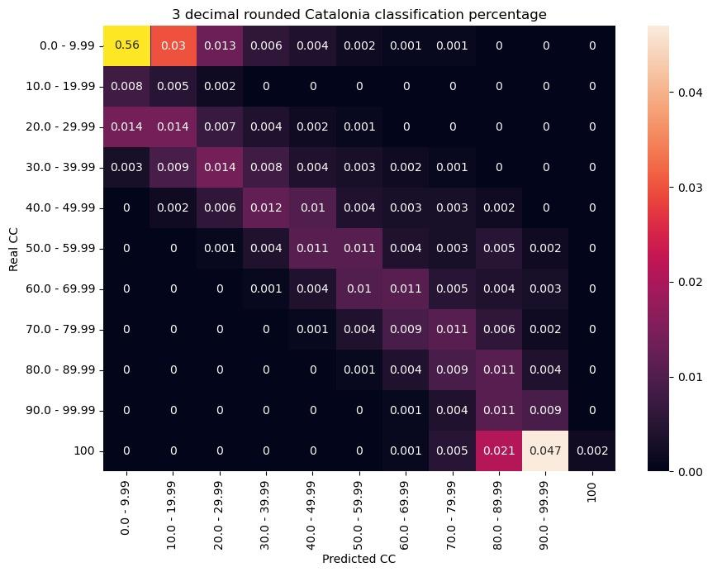
Confusion matrix for classified points
>60% of CC is <10%
Model tends to underestimate
Correcting ICGC overestimation?
Overall good predictions (sparse almost diagonal matrix)

Slide 4
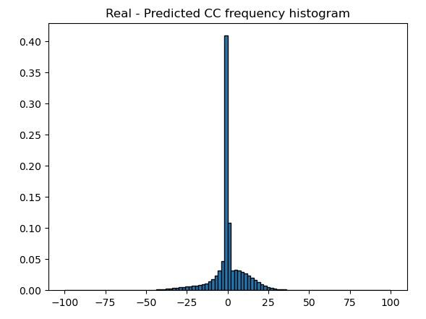
Model’s error distribution
Peaking around zero error.
Overall higher positive error (model tends to underestimate)
Almost no error higher than 25.

Slide 5
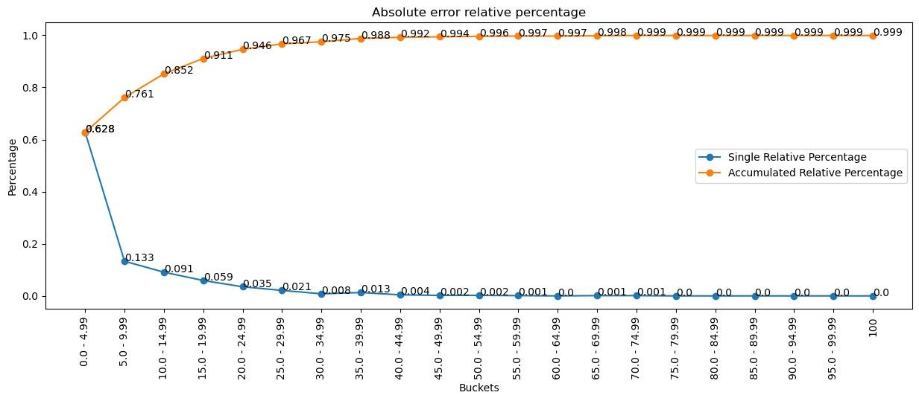
Absolute valued error classification
>62% samples with less than 5% error
>90% samples with less than 20% error
>95% samples with less than 30% error

